Slide 1
Title: Business Process Engineering (BPE)
-
Definition: BPE is a systematic approach to improving business processes

Slide 2
Importance of BPE
Improves efficiency and effectiveness
Enhances customer satisfaction
Increases productivity and quality
Supports business growth and innovation

Slide 3
BPE Methodology
- Overview of the BPE process:
1. Process identification
2. Process analysis
3. Process design
4. Process implementation
5. Process monitoring and evaluation

Slide 4
Process Identification
Techniques for identifying processes:
- Process mapping
- SWOT analysis
- Stakeholder analysis

Slide 5
Process Analysis
Tools for analyzing processes:
- Root cause analysis
- Fishbone diagrams
- Pareto analysis

Slide 6
Process Design
- Principles for designing processes:
- Simplification
- Standardization
- Automation

Slide 7
Process Implementation
Strategies for implementing processes:
- Change management
- Training and development
- Communication planning

Slide 8
Process Monitoring and Evaluation
Metrics for measuring process performance:
- Cycle time
- Throughput - Quality
- Customer satisfaction

Slide 9
BPE Tools and Techniques
- Business process modeling notation (BPMN)
- Lean
- Six Sigma

Slide 10
Business Process Model and Notation (BPMN)
Business Process Model and Notation (BPMN) is a standard for business process modeling that provides a graphical notation for specifying business processes. The main elements of BPMN are:
1. _Events_: Represented by circles, events trigger or result from a process.
2. _Activities_: Represented by rectangles, activities are tasks or operations performed in a process.
3. _Gateways_: Represented by diamonds, gateways control the flow of a process.
4. _Flows_: Represented by arrows, flows connect elements and show the sequence of a process.

Slide 11
Business Process Model and Notation (BPMN)(Cont)
5. _Pools_ and _Lanes_: Represented by rectangles, pools and lanes organize and categorize activities.
6. _Artifacts_: Represented by various shapes, artifacts provide additional information about a process.

Slide 12
Business Process Model and Notation (BPMN)(Cont)
BPMN also includes various symbols and markers to indicate:
- Start and end events
- Conditional flows (e.g., yes/no, true/false)
- Parallel and sequential flows
- Loops and iterations
- Errors and exceptions
- Data inputs and outputs
BPMN is used to create visual models of business processes, making it easier to understand, analyze, and improve them.

Slide 13

Lean
Lean process, also known as Lean methodology, is a management approach that aims to maximize value for customers while minimizing waste and optimizing workflows. The core principles of Lean process are:
1. _Define Value_: Identify the value-added activities from the customer's perspective.
2. _Map the Value Stream_: Visualize the entire process to identify waste and areas for improvement.
 | ReplyForward

Slide 14
Lean(Cont)
3. _Create a Future State_: Design an ideal process with minimal waste and maximum efficiency.
4. _Implement Just-in-Time (JIT) Production_: Produce and deliver products or services just in time to meet customer demand.
5. _Continuously Improve_: Encourage a culture of ongoing improvement and learning.

Slide 15
Key Lean tools and techniques:
1. _Value Stream Mapping (VSM)_
2. _Root Cause Analysis (RCA)_
3. _Kaizen Events_
4. _Kanban Boards_
5. _Total Productive Maintenance (TPM)_
6. _Continuous Improvement (CI)_
7. _PDCA (Plan-Do-Check-Act) Cycle_

Slide 16
Benefits of Lean process:
1. _Reduced waste and costs_
2. _Improved efficiency and productivity_
3. _Enhanced customer satisfaction_
4. _Faster delivery times_
5. _Increased employee engagement and empowerment_
Lean process is widely applied in various industries, including manufacturing, healthcare, software development, and services.

Slide 17
SIX SIGMA
Six Sigma is a data-driven approach to quality management that aims to reduce defects and variations in processes, products, and services.
The Six Sigma process follows the DMAIC (Define, Measure, Analyze, Improve, Control) framework:
1. *Define*:
- Identify the problem or opportunity for improvement
- Define the project scope and goals
- Establish the project team
 | ReplyForward

Slide 18
SIX SIGMA(Cont)
2. *Measure*:
- Collect data to understand the current process
- Identify key performance indicators (KPIs)
- Determine the baseline performance
3. *Analyze*:
- Analyze data to identify root causes of defects and variations
- Identify opportunities for improvement
- Develop hypotheses for improvement

Slide 19
SIX SIGMA(Cont)
4. *Improve*:
- Develop and implement solutions to address root causes
- Pilot test and refine solutions
- Implement changes across the organization
5. *Control*:
- Monitor and control the improved process
- Implement controls to sustain improvements
- Continuously monitor and evaluate performance

Slide 20
SIX SIGMA(Cont)
Six Sigma belts:
1. *White Belt*: Basic knowledge of Six Sigma principles
2. *Yellow Belt*: Participates in improvement projects
3. *Green Belt*: Leads small-scale improvement projects
4. *Black Belt*: Leads complex improvement projects
5. *Master Black Belt*: Expert-level, oversees multiple projects

Slide 21
SIX SIGMA(Cont)
Benefits of Six Sigma:
1. *Reduced defects and variations*
2. *Improved quality and reliability*
3. *Increased customer satisfaction*
4. *Cost savings and efficiency gains*
5. *Enhanced employee engagement and skills*
Six Sigma is widely applied in various industries, including manufacturing, healthcare, finance, and services.

Slide 22
BPE Process Analysis Tools

Slide 23
BPE Process Analysis Tools
Definition: Process analysis is a critical step in BPE that helps identify areas for improvement

Slide 24
Slide 2: Types of Process Analysis Tools
- Overview of different types of tools:
- Qualitative tools
- Quantitative tools
- Hybrid tools

Slide 25
Qualitative Process Analysis Tools
- Tools for understanding process dynamics:
- Root Cause Analysis (RCA)
- Fishbone Diagrams (Ishikawa)
- SWOT Analysis
- Process Mapping

Slide 26
Root Cause Analysis (RCA)
Definition: Method for identifying underlying causes of problems
- Steps:
1. Define the problem
2. Gather data
3. Identify possible causes
4. Analyze and prioritize causes
5. Implement solutions

Slide 27
Fishbone Diagrams (Ishikawa)
Definition: Visual tool for identifying and organizing possible causes
- Steps:
1. Identify the problem
2. Brainstorm possible causes
3. Categorize causes (equipment, materials, etc.)
4. Analyze and prioritize causes

Slide 28
Fishbone Diagram(Ishikawa)
A Fishbone Diagram, also known as an Ishikawa Diagram or Cause-and-Effect Diagram, is a tool used to identify and organize the possible causes of a problem. It is shaped like a fishbone, with the problem statement at the head and the various causes branching out from there.

Slide 29
Fishbone Diagram(Ishikawa)(Cont)
The typical categories used in a Fishbone Diagram are:
1. _Man_ (People): workforce, training, skills, etc.
2. _Machine_ (Equipment): hardware, software, tools, etc.
3. _Material_ (Inputs): raw materials, supplies, etc.
4. _Method_ (Processes): procedures, workflows, etc.
5. _Measurement_ (Data): metrics, feedback, etc.
6. _Environment_ (External Factors): external conditions, context, etc.

Slide 30

Fishbone Diagram(Ishikawa)(Cont)

Slide 31
Fishbone Diagram(Ishikawa)(Cont)
To create a Fishbone Diagram
1. Write the problem statement at the head of the fishbone.
2. Brainstorm possible causes under each category.
3. Use arrows to connect the causes to the problem statement.
4. Identify the root causes by asking "why" and drilling down to the underlying reasons.

Slide 32
Benefits of Fishbone Diagrams:
1. Structured approach to problem solving
2. Identifies multiple causes of a problem
3. Encourages teamwork and collaboration
4. Helps prioritize causes for further investigation
5. Visual representation of complex relationships
Fishbone Diagrams are widely used in quality management, process improvement, and problem-solving initiatives.

Slide 33
Here is a context for a Fishbone Diagram (Ishikawa):
*Problem Statement:* High Employee Turnover Rate
*Fishbone Diagram:*

Slide 34
Here is a context for a Fishbone Diagram (Ishikawa)(Cont)
Fishbone Diagram:*
- *Man (People)*
- Lack of training and development opportunities
- Poor management and leadership
- Unsatisfying work environment
- Inadequate compensation and benefit

Slide 35
Here is a context for a Fishbone Diagram (Ishikawa)(Cont)
Machine (Equipment)*
- Outdated technology and tools
- Inefficient processes and workflows
- *Material (Inputs)*
- Poor communication and feedback
- Unclear expectations and goals

Slide 36
Here is a context for a Fishbone Diagram (Ishikawa)(Cont)
Method (Processes)*
- Ineffective recruitment and selection process
- Lack of employee recognition and rewards
- *Measurement (Data)*
- Inadequate performance metrics and tracking
- *Environment (External Factors)*
- High demand for skilled workers in the industry
- Economic conditions and job market

Slide 37
Here is a context for a Fishbone Diagram (Ishikawa)(Cont)
*Root Cause:* Lack of effective leadership and management, leading to poor work environment and low employee satisfaction.
This Fishbone Diagram helps identify the various factors contributing to the high employee turnover rate, allowing for a more comprehensive approach to addressing the problem.

Slide 38
PARETO DIAGRAM(ISHIKAWA)
A Pareto chart is a graphical representation of data that helps identify the most significant factors or problems in a process or system. It's named after Vilfredo Pareto, an Italian economist who observed that approximately 80% of Italy's land was owned by 20% of the population.

Slide 39
PARETO DIAGRAM(ISHIKAWA)
A Pareto chart typically consists of:
1. A bar chart showing the frequency or impact of different factors or problems.
2. A line chart showing the cumulative total of these factors.

Slide 40
PARETO DIAGRAM(ISHIKAWA)
The chart is arranged in descending order, with the most significant factors on the left. The goal is to identify the "vital few" factors that have the greatest impact, rather than getting bogged down by the "trivial many."

Slide 41
PARETO DIAGRAM(ISHIKAWA)(Cont)
Pareto charts are commonly used in quality control, business, and engineering to:
- Identify the most common problems or defects
- Determine the root causes of issues
- Prioritize solutions or improvements
- Monitor progress over time

Slide 42
PARETO DIAGRAM(ISHIKAWA)(Cont)
Pareto analysis is a method used to identify the most significant factors or problems in a process or system. It's based on the Pareto principle, which states that approximately 80% of effects come from 20% of causes.

Slide 43
PARETO DIAGRAM(ISHIKAWA)(Cont)
Here's a step-by-step guide to performing a Pareto analysis:
1. *Collect data*: Gather data on the problems or factors you want to analyze.
2. *Categorize*: Group similar problems or factors together.
3. *Count*: Count the frequency or impact of each category.
4. *Rank*: Rank the categories in descending order of frequency or impact.
5. *Plot*: Create a Pareto chart to visualize the data.
6. *Analyze*: Identify the "vital few" categories that account for the majority of the problems or effects.
7. *Prioritize*: Prioritize solutions or improvements based on the analysis.

Slide 44
PARETO DIAGRAM(ISHIKAWA)(Cont)
Example:
| Category | Frequency |
| --- | --- |
| A | 30 |
| B | 20 |
| C | 15 |
| D | 10 |
| E | 5 |
In this example, category A accounts for 30% of the problems, followed by category B with 20%. Together, they account for 50% of the problems, making them the "vital few" areas to focus on.

Slide 45
PARETO DIAGRAM(ISHIKAWA)(Cont)
Pareto analysis helps you:
- Identify the most critical problems or factors
- Prioritize solutions or improvements
- Focus resources on the most impactful areas
- Monitor progress over time

Slide 46
PARETO DIAGRAM(ISHIKAWA)(Cont)
Here is a context for Pareto analysis:
*Problem:* A manufacturing company is experiencing a high rate of product defects, resulting in increased costs and customer dissatisfaction.
*Goal:* Identify the most common causes of product defects to prioritize quality improvement efforts.

Slide 47
PARETO DIAGRAM(ISHIKAWA)(Cont)
*Data Collection:*- Collected data on defect types and frequencies over a 3-month period
- Categorized defects into 5 main categories: Material, Machinery, Labor, Design, and Packaging

Slide 48
*Pareto Analysis:*
| Category | Frequency | Cumulative % |
| --- | --- | --- |
| Material | 40 | 40% |
| Machinery | 25 | 65% |
| Labor | 15 | 80% |
| Design | 10 | 90% |
| Packaging | 5 | 95% |
 | ReplyForward

Slide 49
*Pareto Analysis:*(Cont)
*Insights:*
- Material defects account for 40% of all defects
- Machinery and Labor defects combined account for an additional 25%
- These three categories account for 80% of all defects
*Conclusion:*
- Prioritize quality improvement efforts on Material, Machinery, and Labor categories
- Implement changes to material sourcing, machinery maintenance, and labor training to address these defects
By applying Pareto analysis, the company can focus on the most critical areas, reducing defects and improving overall quality.

Slide 50
Pareto Chart (Manufacturing Example)
The Pareto Chart is a tool used to rank the various categories/causes of a problem by charting them as bars in descending order of frequency or magnitude from left to right. It helps establish priorities by dividing the causes into the ‘vital few’ and the ‘trivial many’.
The theory behind the Pareto Chart originated in 1897 when an Italian economist named Vilfredo Pareto created a formula representing the uneven distribution of wealth - what later came to be known as the 80-20 rule.

Slide 51
You have probably heard a version of it like: "20% of the people cause 80% of the problems", or a derivative. Dr. J. M. Juran started applying this principal to defect analysis.
In fact, many (most) defect distributions follow a similar pattern, with a relatively small number of issues accounting for an overwhelming share of the defects.
Following is an example of paint defects from an automotive assembly plant:

Slide 52
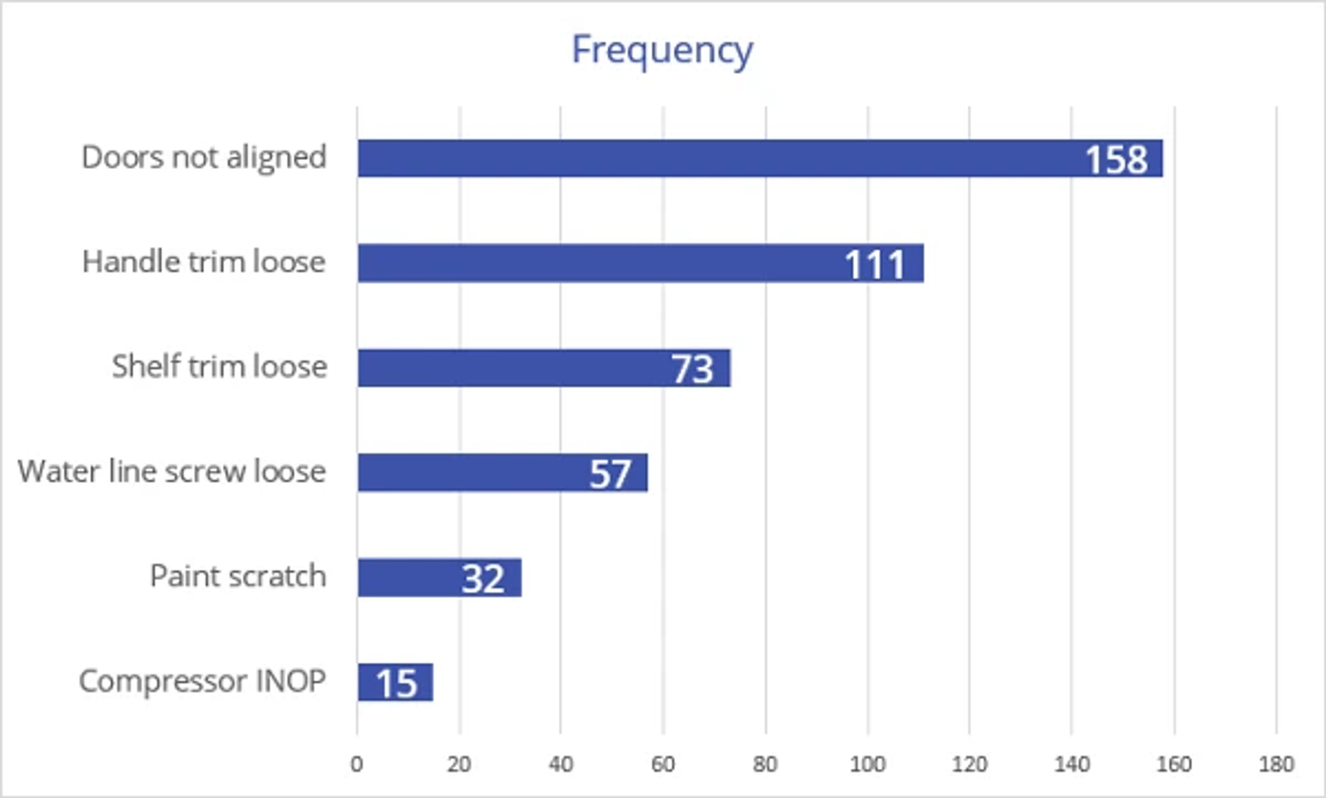

Slide 53
Choosing the Right Pareto Chart Software
Problems inside an organization can have many causes. As a result, it’s essential to identify the issues driving the largest share of them - and the difficulties whose fixes would have the greatest impact. EngineRoom’s Pareto Chart tool is an efficient and effective way to turn data on problem frequency into actionable insights on what to prioritize in the next steps of the problem-solving cycle.

Slide 54
EngineRoom’s Pareto Chart tool meets users where they are in the data-gathering process: Users can begin by inputting raw, unaggregated data or data already grouped into categories, along with the frequency at which a problem occurs. From there, they can add or remove critical variables like problem frequency or cost to correct through a user-friendly “drop zone.”

Slide 55
EngineRoom also allows users to customize the Pareto Chart by toggling a cumulative frequency line or allowing the tool to automatically group data after counting a certain percentage of observations.

Slide 56
Ultimately, this quick process produces a results chart that will enable users to pinpoint high-value targets for future fixes. With EngineRoom’s Pareto Chart tool, the leap from raw data to clarity on the next steps is quick and simple.

Slide 57
Summary
The Pareto Chart is a simple to use and powerful graphic to identify where the majority of problems in a process are originating. Using a Pareto Chart early in problem solving is an effective strategy to decrease project complexity.

Slide 58
Quantitative Process Analysis Tools
- Tools for measuring process performance:
- Statistical Process Control (SPC)
- Regression Analysis
- Simulation Modeling
- Benchmarking

Slide 59
Statistical Process Control (SPC)
Definition: Method for monitoring and controlling process variability
- Steps:
1. Establish control limits
2. Collect data
3. Plot data on control charts
4. Take corrective action when necessary

Slide 60
Statistical Process Control (SPC)(Cont)
Certainly! Statistical Process Control (SPC) involves using statistical methods to monitor and control a process to ensure it operates at its full potential. Here's a pictorial explanation of SPC:

Slide 61
Statistical Process Control (SPC)(Cont)
Process Flow Diagram:
Input: Raw materials or initial data.
Process: The transformation or operation
(e.g., manufacturing, service delivery).
Output: Final product or outcome.

Slide 62
Statistical Process Control (SPC)(Cont)
[Input] --> [Process] --> [Output]
Control Charts:
Purpose: To track process performance over time and identify any variations.

Slide 63
Control Charts:
Purpose: To track process performance over time and identify any variations.
Components:
Center Line: The average or target value of the process.
Upper Control Limit (UCL): The highest value the process should reach.
Lower Control Limit (LCL): The lowest value the process should reach.
Data Points: Individual measurements or results plotted over time.

Slide 64
Types of Variation:
Common Cause Variation: Natural, inherent variation in the process.
Special Cause Variation: Variation due to specific, identifiable factors.

Slide 65
Steps in SPC:
Collect Data: Gather measurements from the process.
Plot Data on Control Charts: Visualize the data over time.
Analyze: Determine if the process is in control (i.e., all data points are within control limits and random patterns).
Act: Take corrective actions if the process shows signs of special cause variation

Slide 66
Steps: 1. Collect Data 2. Plot on Control Chart 3. Analyze for Control 4. Take Action

Slide 67
SPC Tools:
X-bar and R Charts: Monitor the mean and range of samples.
P-Charts: Monitor the proportion of defective items.
NP-Charts: Monitor the number of defective items in a sample.

Slide 68
summary, SPC helps in maintaining a consistent and high-quality process by using statistical tools to monitor and control variability, ensuring that the process remains stable and efficient.

Slide 69
THANKS

